Slide 1
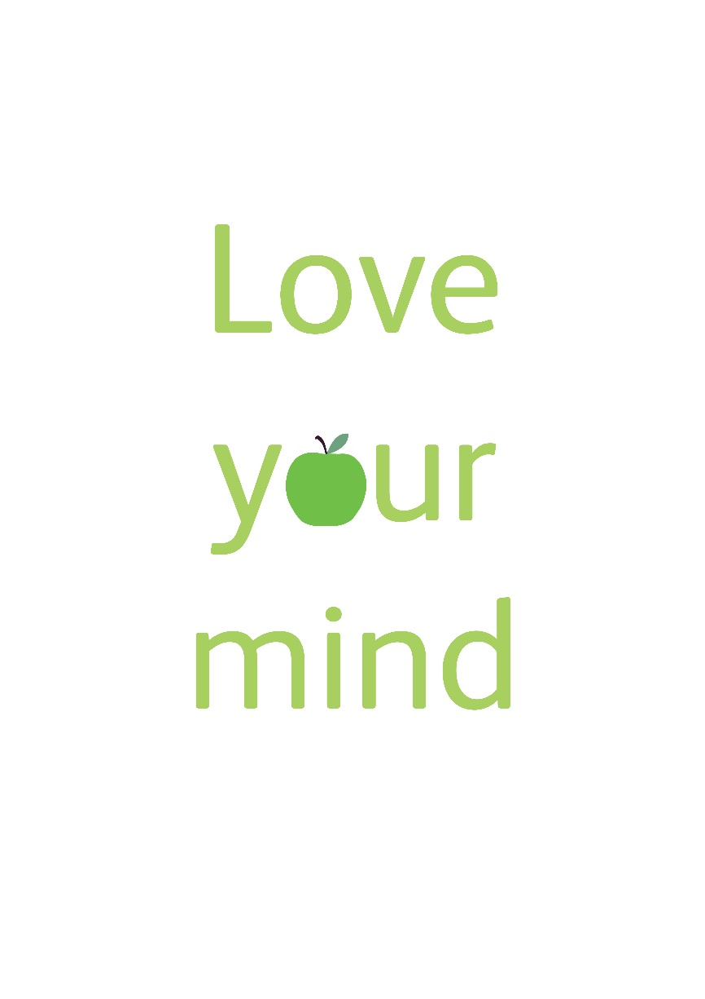
Senior School: Wellbeing

Slide 2
Wellbeing: Context
Mindfulness@ St George’s
Goldie Hawn: Mind UP
Elaine Bradley: Sound Mind
Mindfulness for Stress (trained 27 of JS staff)
Mindfulness for Self Compassion
Mindfulness in Schools Project paws b /.b
Relax Kids

Slide 3
Wellbeing
Love your mind is about helping people to find ways to keep fit and healthy in terms of their emotional and mental health.
We all know that to be physically healthy we need to eat a good diet and take part in regular exercise.
What we are less aware of as a society is that there are things we can do to improve our emotional and mental health.

Slide 4
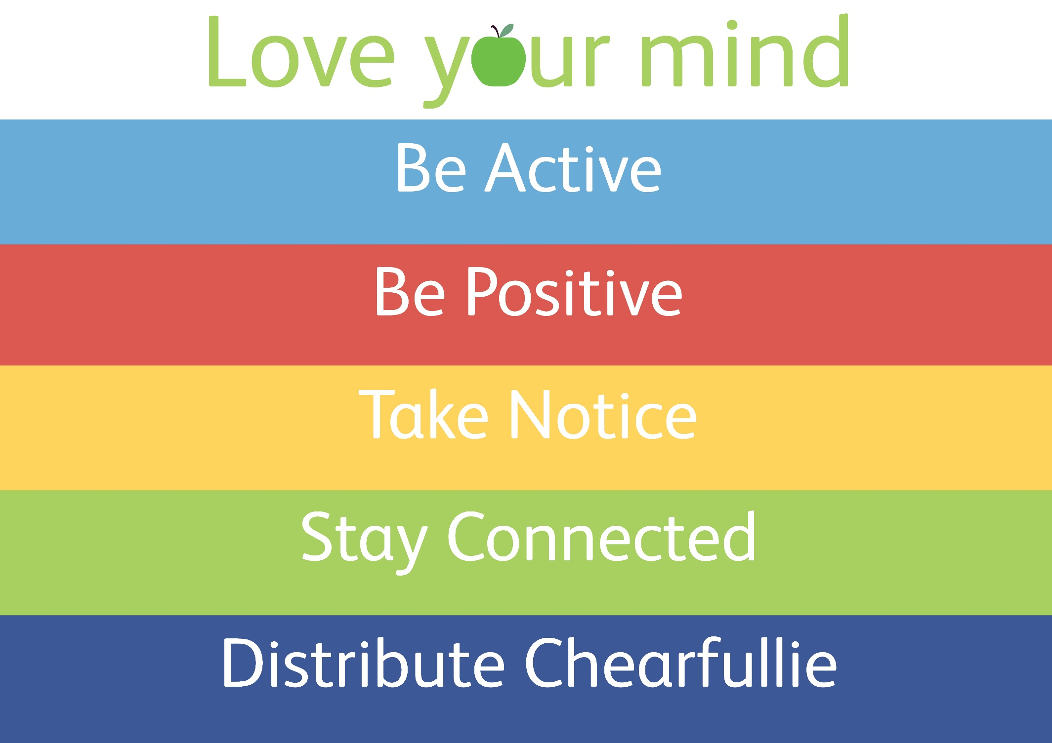
Notes:
The 5 activities you can do that can promote your emotional wellbeing- these link to the video. Terminology is slightly different.

Slide 5
Wellbeing: Context
Junior School
P4 - Goldie Hawn: Mind Up
P6/P7 Mindfulness in Schools Project paws b

Slide 6
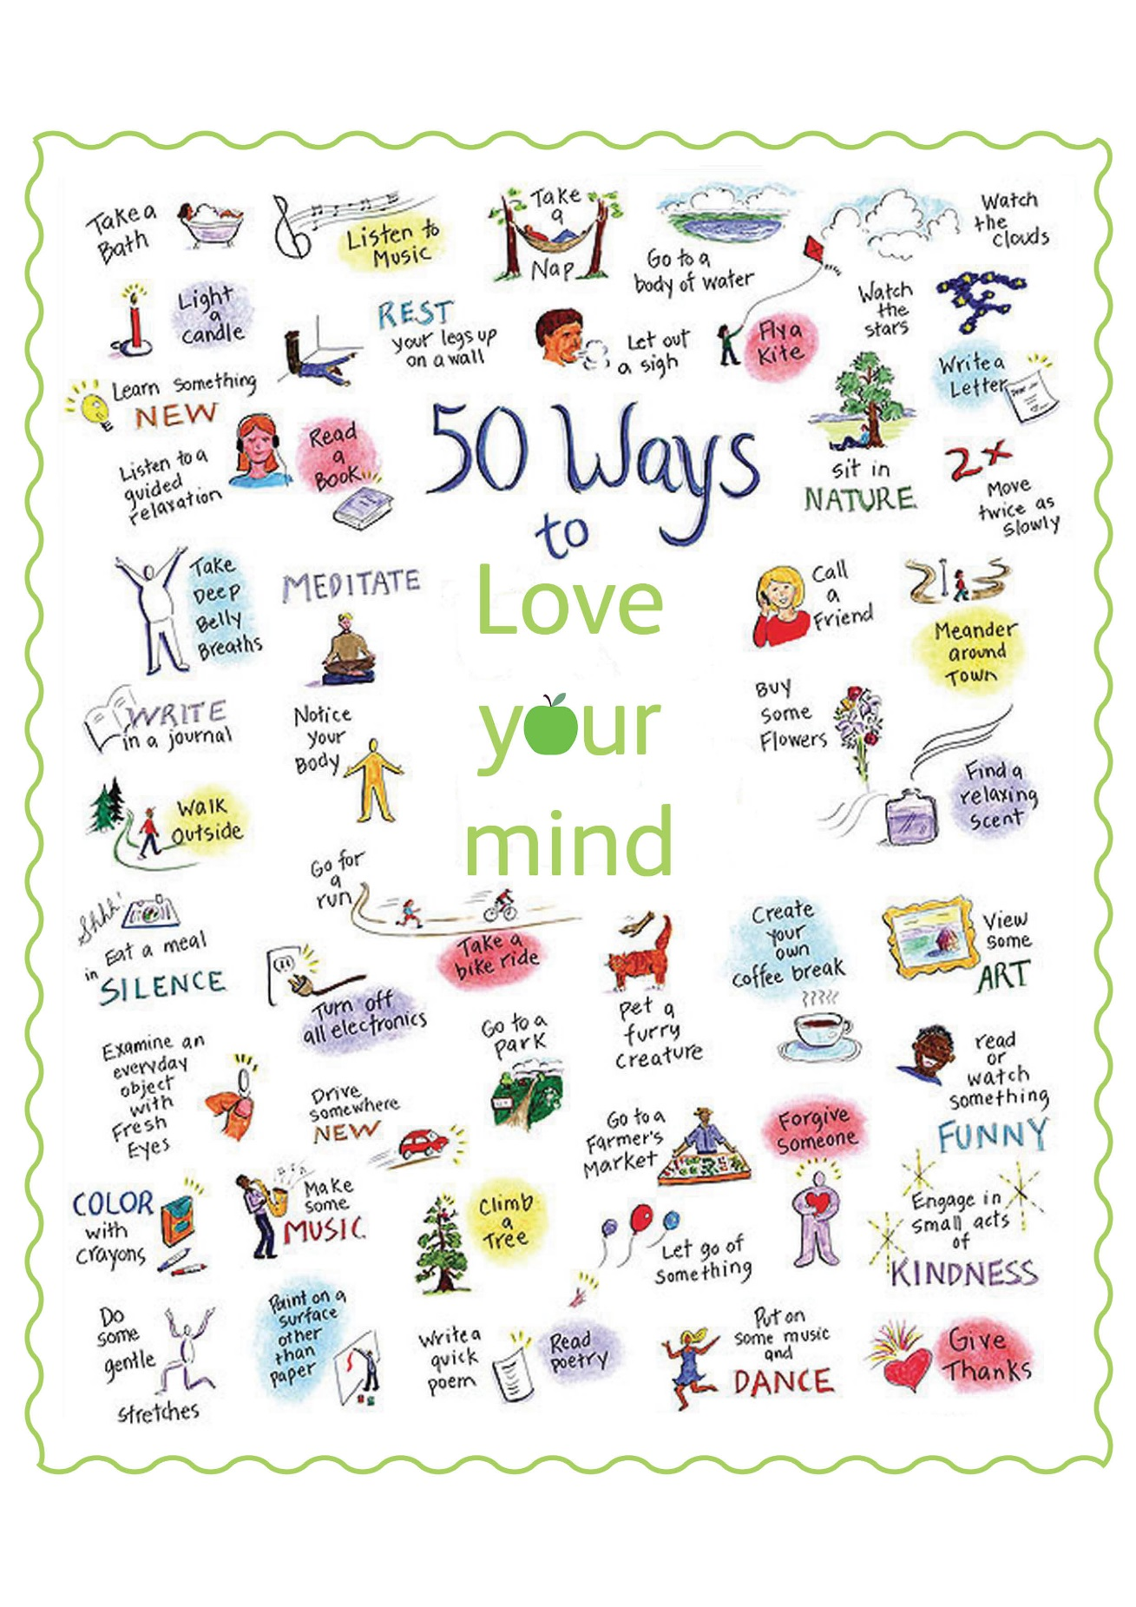

Slide 7
Senior School: Wellbeing
Citizenship Classes
S1 Wednesday Morning Activities
Head Gardeners
Core Music
Sleep Week
LoveYourMindGHS.com
Pupil Support Groups
Parents/Guardians Pastoral Care Evening
Self Compassion- Focus for 2017/18

Slide 8
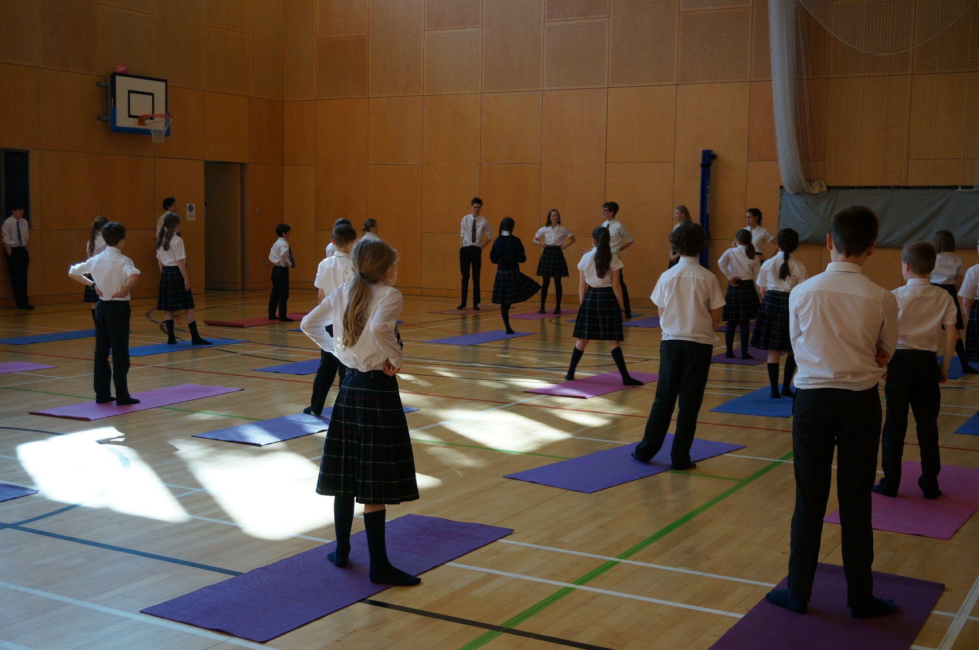
Citizenship

Slide 11
Senior School: Wellbeing
The Head Gardeners are working to promote wellbeing and the message in our community.

Slide 12
Sleep Week SS and JS
Look out for the Good Sleep posters
Come take part in Mellow Monday, Wake up Wednesday and Fun House Friday
Check your school email for more information

Slide 13
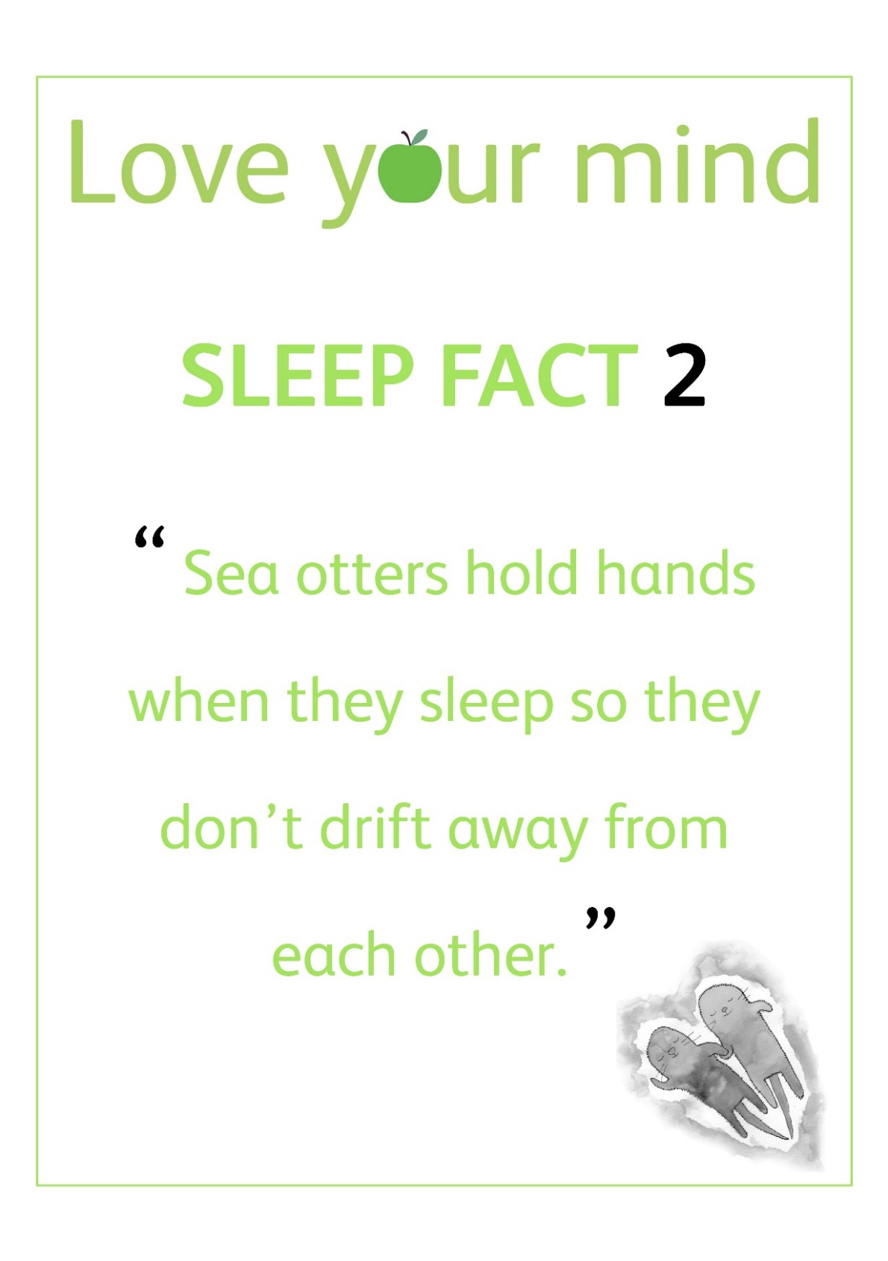

Slide 14
What has worked?
Understanding Your Brain
Clear message
Branding
Pupil Involvement
Citizenship
Registration classes
Senior School/Junior School Links
Staff Training

Slide 15
The Future…
Talk the talk and walk the walk
Wellbeing in the Classroom
Wellbeing toolkit for staff
Self Compassion

